Slide 1

RUNGTA COLLEGE OF DENTAL SCIENCES & RESEARCH
TITLE OF THE TOPIC- ROOT RESORPTION
DEPARTMENT OF CONSERVATIVE DENTISTRY AND ENDODONTICS

Slide 2
Specific learning Objectives
At the end of this presentation the learner is expected to know ;
Core areas* | Domain ** | Category #
Introduction | Cognitive | Must know
Classification | Cognitive | Must know
Methods | Psychomotor | Must know
*Subtopic of importance
** Cognitive, Psychomotor or Affective
# Must know , Nice to know & Desire to know
( Table to be prepared as per the above format )

Slide 3
CONTENTS
Introduction
Definition
History
Classifications
Mechanism of resorption
Regulatory factors
Systemic regulatory factors
Local regulatory factors
Resorption due to systemic causes
Resorption due to local causes
Problems in working length determination
Role of emdogain
Periodontal regeneration
Repair of resorption
Conclusion
References

Slide 4
Root canal replacement resorption (metaplastic resorption)
-Internal inflammatory resorption which is again of 2 types:
Transient
Progressive
INTERNAL RESORPTION
Nee et al 1999

Slide 5
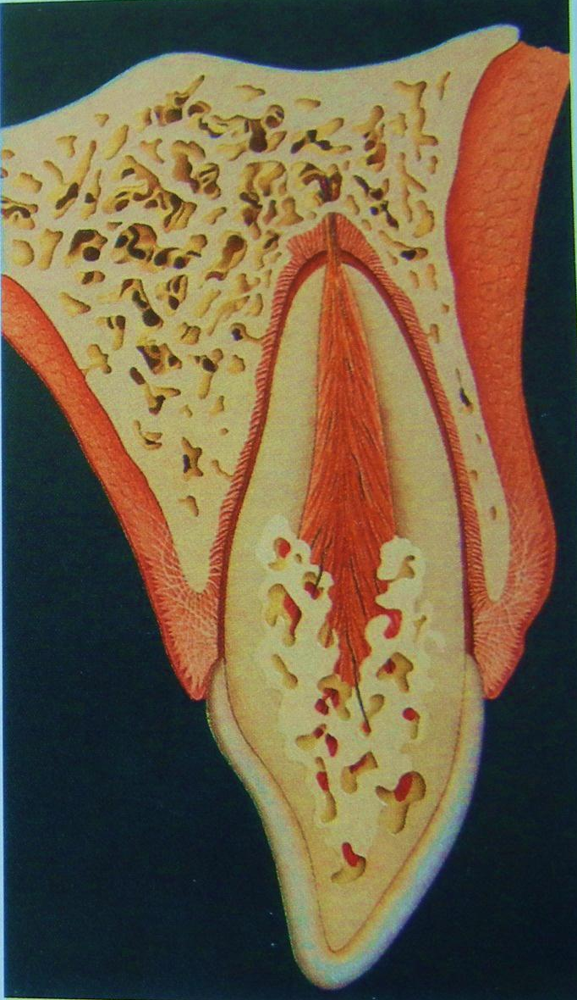
ROOT CANAL REPLACEMENT RESORPTION
(METAPLASTIC RESORPTION)
Also called Internal ankylotic resorption (Andreasen 1994).
Resorption of dentin and subsequent deposition of hard tissue that resembles bone or cementum occurs but not dentin.
Resorbing tissue is not of pulpal origin but is 'metaplastic' tissue derived from the pulpal invasion of macrophage-like cells (Stanley 1965).
Pulp tissue was replaced by periodontium-like connective tissue (Wedenberg et al 1987)⁴⁰

Slide 6
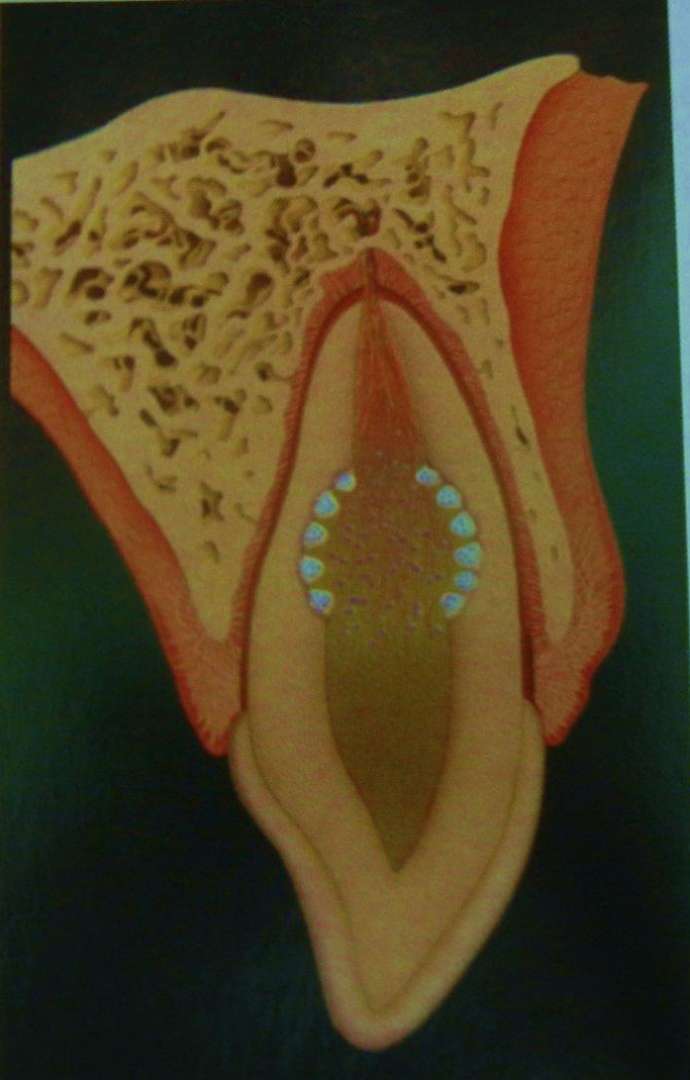
INTERNAL INFLAMMATORY RESORPTION
Transient type
Frequently in traumatized teeth with orthodontic/periodontic treatment.(Andreasen 1994)
-Progressive type
Internal inflammatory resorption (Andreasen 1994) requiring continuous stimulation by infection through orientation of dentinal tubules.
Only loss of odontoblasts and predentin.
Very shallow and self limiting and is repaired with new hard tissue.

Slide 7
INTERNAL TUNNELING RESORPTION
– VARIANT
Usually found in the coronal portion of root fractures but might also be seen after luxation injuries. The resorption process tunnels into the dentin adjacent to the root canal with concomitant deposition of bone like tissues in some regions. These bone like tissues have the appearance of cancellous bone instead of compact bone.

Slide 8

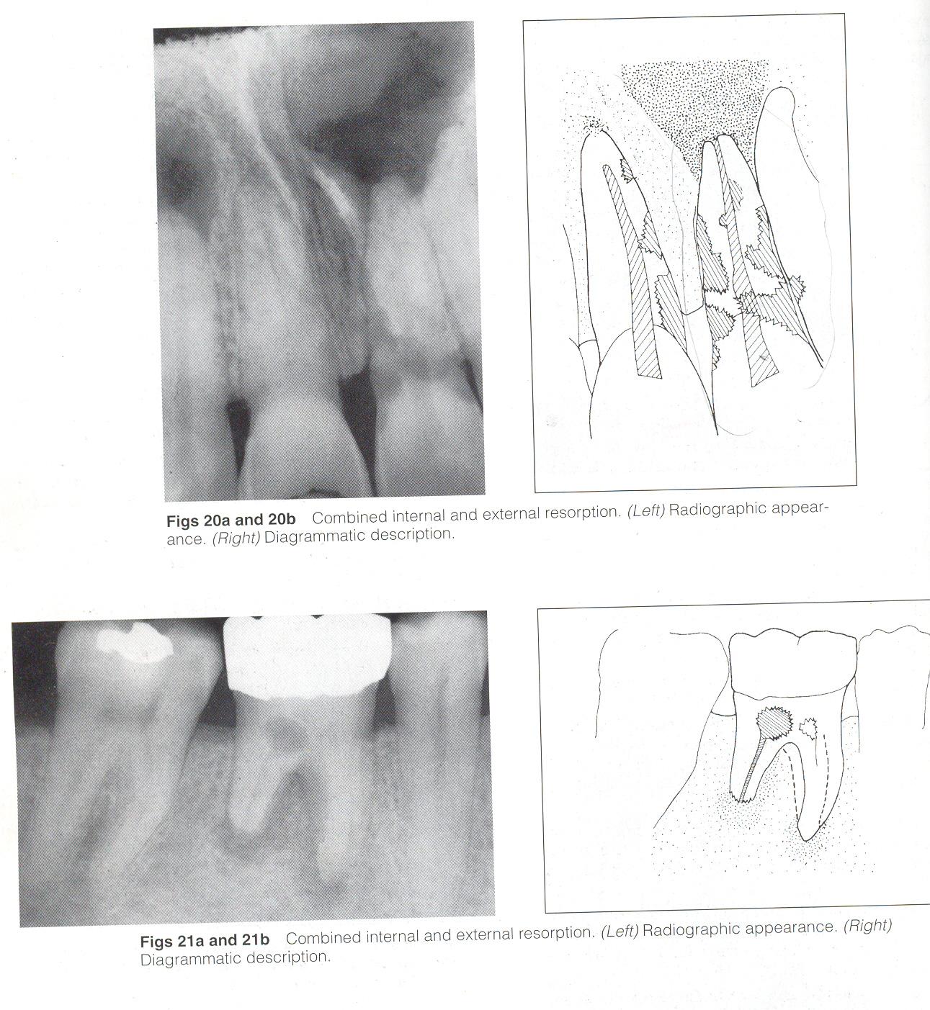
COMBINED INTERNAL AND EXTERNAL RESORPTION
-
Can occur simultaneously on the same tooth and may appear as separate or joined defects. It may eventually communicate.
(Nee et al 1999)

Slide 9
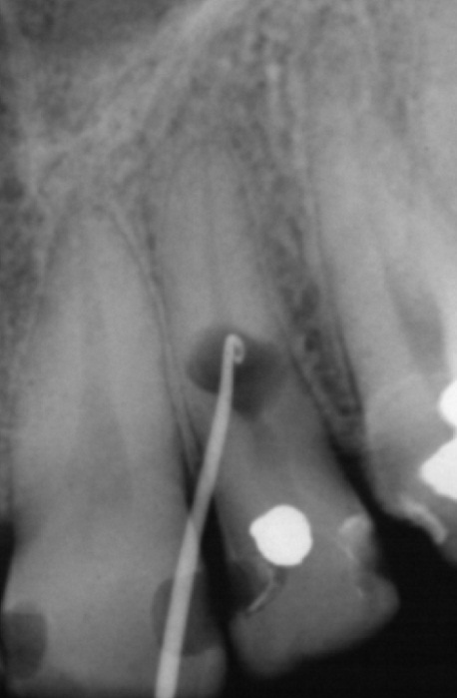
DIAGNOSIS
CLINICAL MANIFESTATIONS
Usually asymptomatic.
Pain may occur if the pulp is partially vital or if perforation occurs.
Following total pulpal necrosis – eventually S/S apical periodontitis
Sinus tracts – indicative of root perforation or Ch. PA abscess
Pulp tests may indicate vitality or necrosis
A part of pulp may be vital, so that +ve response to pulp sensitivity testing is expected.
If resorption takes place in the coronal portion of the tooth, it may exhibit a pinkish or reddish hue (pink spot).

Slide 10
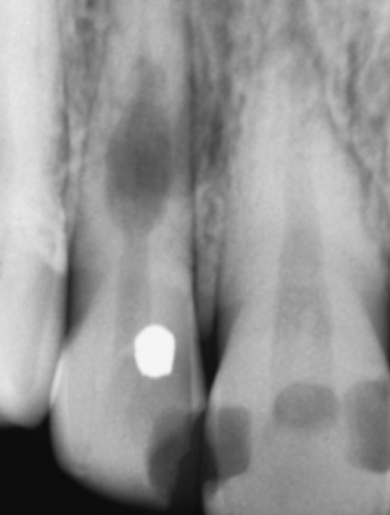
RADIOGRAPHIC EVALUATION
Internal inflammatory resorption appears as circumscribed, oval enlargement (radiolucency) continuous with the root canal wall.
The defect does not change its relation to the tooth, when the X –ray is projected from an angulation.

Slide 11
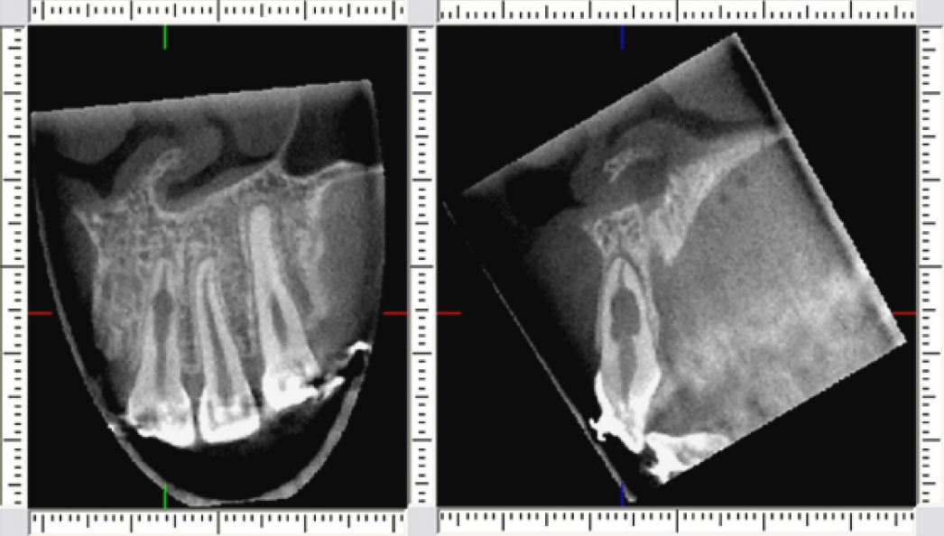
‘CBCT results in perfect diagnosis and provides clinician with a 3-D appreciation of the tooth, the resorption lesion and the adjacent anatomy. The true nature of the lesion might be assesed, including root perforations and wether the lesion is amenable to treatment (Patel et al)

Slide 12
RADIOGRAPHIC COMPARISON OF INTERNAL AND EXTERNAL RESORPTION
Gartner et al
FEATURE | INTERNAL RESORPTION | EXTERNAL RESORPTION
Margins | Smooth and well defined | Rough and have a ‘moth eaten’ appearance
Symmetry | Symmetrical | Asymmetrical
Canal anatomy | Altered size - Appears as an expansion of pulp chamber or canal | Unaltered - Appears as a ragged, eating away of the root structure
Different horizontal beam angles | The relationship of the canal to the defect will remain the same, regardless of the angle | The relationship of the canal to the defect will shift as the horizontal angle is altered
Demarcation | Pulp chamber appear as a ghost within defect | Acute delineation b/w the root structure and resorbing front
Bone resorption | Not seen unless perforated | Always associated

Slide 13
DIFFERENTIAL DIAGNOSIS
Entities that must be considered are :
Normal tooth with its variations,
Dental caries,
Early pulpal death
Incomplete root formation,
Invasive cervical resorption, and
External resorption

Slide 14
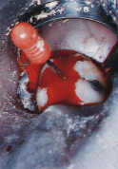
COMMON MISDIAGNOSES
The majority of misdiagnoses of resorptive defects are made in distinguishing subepithelial external and internal root resorption.
In internal root resorption, bleeding within the canal should cease quickly after pulp extirpation if the blood supply to the granulation tissue is the apical blood vessels.
But if bleeding continues during treatment, particularly if it is still present at the second visit, the source of the blood supply is external and treatment for external resorption should be carried out.

Slide 15
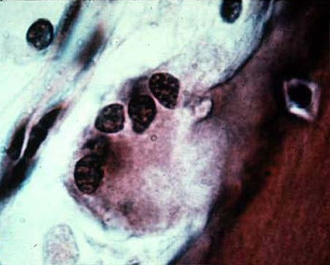
Histologic evaluation
Necrotic zone containing bacteria usually found coronal to resorbing tissue. Normal pulpal tissue is present. Transforms into granulomatous tissue with giant cells that resorb the predentin of the root canal

Slide 16

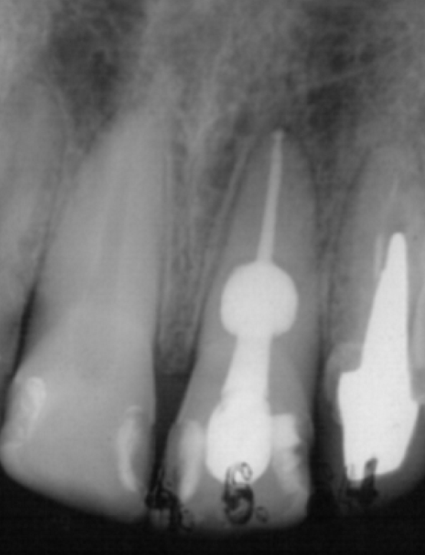
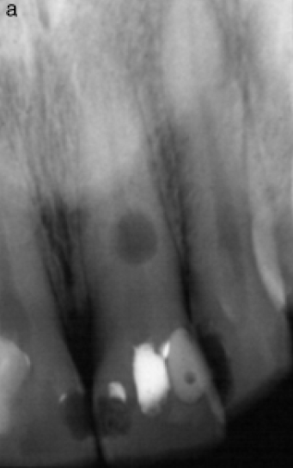
Treatment
No Perforation
Perforation
Raising the flap and sealing the defect
Use of irrigants (NaOCl) / ultrasonics to control hemorrhage and dissolve pulp tissue inaccesible areas
Reverse sandwich technique in perforation repair yields succesful outcome (Kandaswamy)
In presence of extremely large internal resorptive defects in the apical part of the canal, surgically remove the defective root and place an endodontic implant in order to maintain stability of the tooth (Trope 2002)
ICM like CH
Obturation using a softened gutta-percha techniques

Slide 17
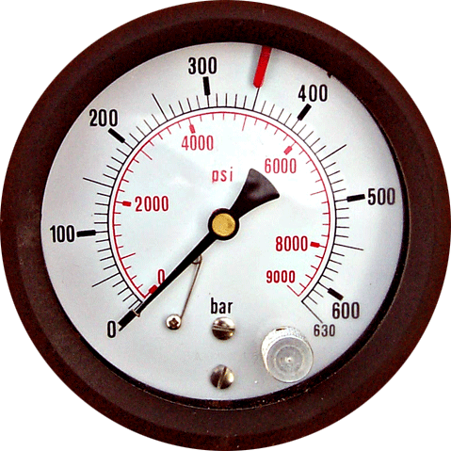
2. Pressure
Due to excessive forces of orthodontic tooth movement .
First comprehensive study on root resorption after orthodontic treatment was done by Ketcham 1929.
Root resorption is one of the adverse outcomes of orthodontic tooth movement.
It compromises the crown-root ratio.

Slide 18
ETIOLOGY
  -Damage to the protective layer
  -Hyalinization of the periodontal ligament
  -Mechanical injury to the cementum
STIMULUS
  -Periodontal infection
  -Continuous orthodontic forces
  -Pulpal infection

Slide 19
Predisposing factors
High-magnitude intrusive forces
Long term orthodontic treatment
Treatment started after age 11
Fixed appliances

Slide 20
Features
Usually considered to be external root resorption.
There are 2 types of root resorption in connection with orthodontic treatment
(Thilander et al 2000)
-Superficial resorptions that undergoes repair
-Apical resorption which leads to permanent root shortening

Slide 21
Features
Periapical replacement resorption (PARR) is defined as a dentistogenic (iatrogenic) disorder that occurs, unpredictably, after orthodontic treatment of permanent incisors, whereby the resorbed apical root portion is replaced with normal bone.
Bender et al 1997
Apical resorption is 4 times more common than lateral resorption Trope & Chivian 1994

Slide 22
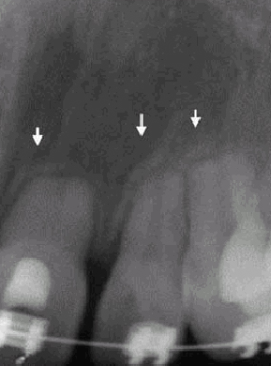

Radiographic evaluation
Blunting phenomenon / rounding of the apex is seen. No radiolucency of bone is observed at the resorption site unlike external inflammatory resorption. In severe cases, crater-like appearance is seen.
Histological resorption in almost 100% of cases but only 19 – 31.4% is observable on a radiograph
Bender et al 1997

Slide 23
Treatment
Cessation of orthodontic treatment
Controlled application of light forces
Non steroidal anti-inflammatory drugs
Systemic use of NSAID’s during initial phase of therapy
Inhibit cyclo-oxygenase and the subsequent production of prostaglandins
Eg Nabumetone
  Villa et al 2004

Slide 24
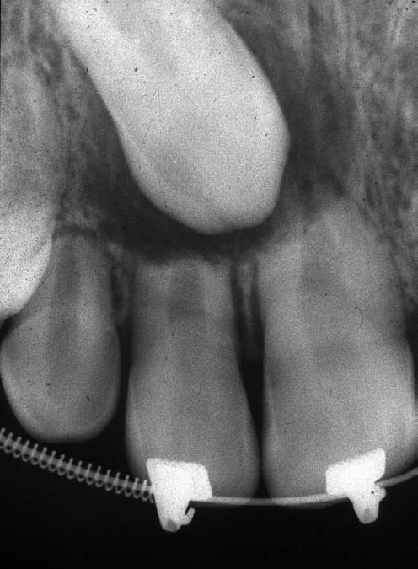
PRESSURE
Pressure due to impacted teeth, tumours or cysts leads to resorption too.
For impacted teeth or tumors, the resorption will occur wherever the pressure from the impaction/tumor occurs . No radiolucency is observed at the resorption site
Treatment is relatively easy, in that removal of the source of the pressure will result in the cessation of resorption in the majority of cases

Slide 25
DENTOALVEOLAR ANKYLOSIS & REPLACEMENT RESORPTION
Replacement resorption | Ankylosis
No difference
Process whereby the root dentin is replaced by bone | Ankylotic fusion between root cementum and bone Trope & Chivian (1994)
No actual union between tooth and bone Presence of intervening inflamed connective tissue Contains inflammatory cells and osteoclastic cells | Actual union between tooth and bone No intervening connective tissue Ne et al (1999)

Slide 26
ETIOLOGY
  Loss or extensive necrosis of periodontal ligament and primarily luxation injuries, especially avulsion. After inflammatory root resorption has been reversed and after auto-transplantation
FEATURES
  It is of 2 types:
-Transient
-Progressive
Progressive ankylosis is seen when greater than 20 % of the root surface is damaged. Rate of progression of ankylosis is directly related to initial damage to root surface and age of patient. It occurs very rapidly in young individuals.

Slide 27
CLINICAL EVALUATION
Typically asymptomatic.
Loss of mobility when more than 10 % of the root surface is ankylosed.
High pitched /metallic percussion tone when 20 % of the root surface is ankylosed.
In a young patient, infraocclusion and incomplete alveolar process development is seen. Lack of a normal mesial drift

Slide 28
RADIOGRAPHIC EVALUATION
  Complete disappearance of the periodontal space . Uneven root surface contour (Moth-eaten appearance)
  No radiolucency observed at resorption site
HISTOLOGIC EVALUATION
  Union between bone and root without intervening connective tissue

Slide 29
RADIOGRAPHIC EVALUATION
  Complete disappearance of the periodontal space . Uneven root surface contour (Moth-eaten appearance)
  No radiolucency observed at resorption site
HISTOLOGIC EVALUATION
  Union between bone and root without intervening connective tissue

Slide 30
TAKE HOME MESSEGE/ FOR THE TOPIC COVERED (SUMMARY)
Tooth resorption is a perplexing problem for all dental practitioners. The etiologic factors are vague, diagnoses are educated guesses, and often the chosen treatment does not prevent the rapid disappearance of the calcified dental tissues.

Slide 31
Question & Answer Session
Write a short note on repair of resorption.
Short note on idiopathic resorption.
Short note on internal inflammatory resorption.
Write in brief classification of resorption.

Slide 32

REFERENCES

Slide 33
Martin Trope, Noah Chivian ; Root Resorption : Pathways of Pulp Cohen and Burns, 6th Edition.
Fuss Z, Tsesis I, Lin S. : Root resorption – diagnosis, classification and treatment choices based on stimulation factors. Dent Traumatol 2003:19:175-182.
M. Laux, P.V. Abbott, G. Pajarola and P.N.R. Nair : Apical inflammatory root resorption : a correlative radiographic and histological assessment : International Endodontic Journal , 33, 483-493, 2000.
Ne RP, Witherspoon DE, Glutman JL: Tooth resorption. Quintessence Int. 30:9-25, 1999.
J.O. Andreasen : Response of oral tissues to trauma. M. Torabinejad and R.D. Finkelman, inflammation and mediators of hard tissue resorption.

Slide 34


